Slide 1
What and When?
Course: User Research (TABG17-A17)
Lecture 2

Slide 2
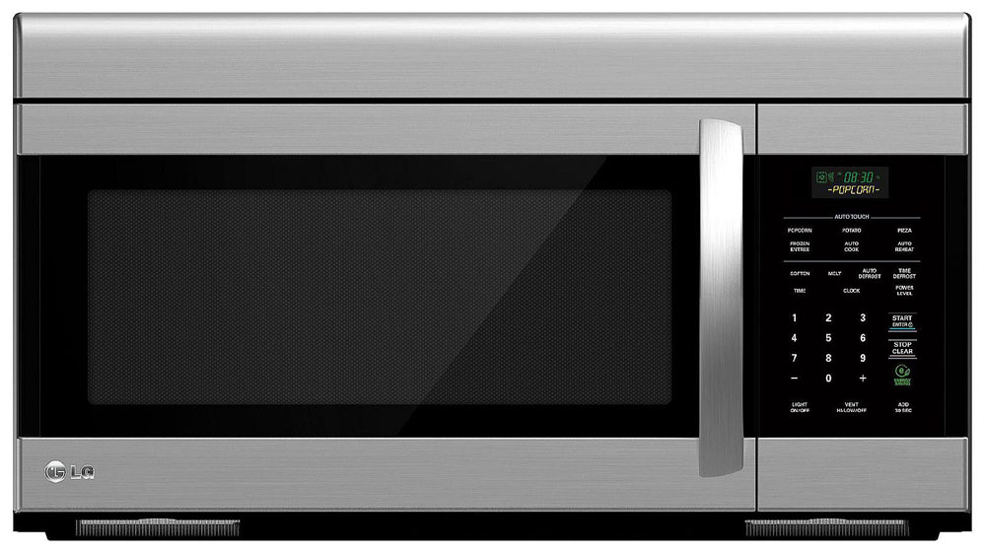

Slide 3
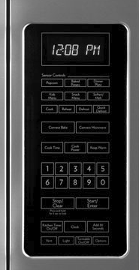

Slide 4
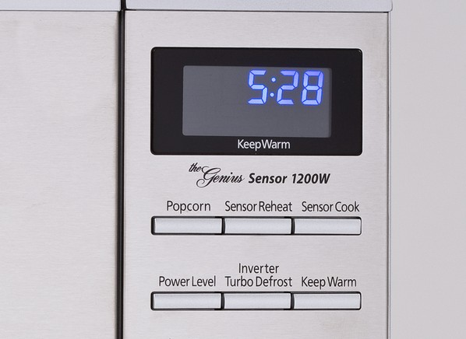
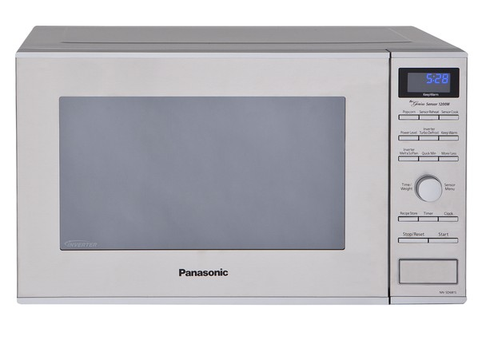
-

Slide 5
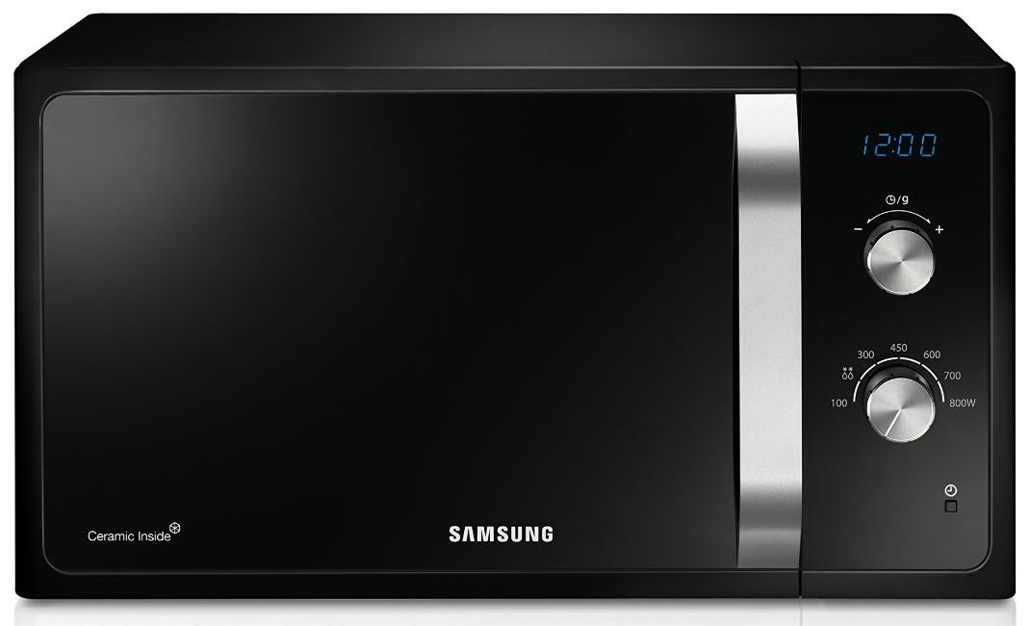

Slide 6
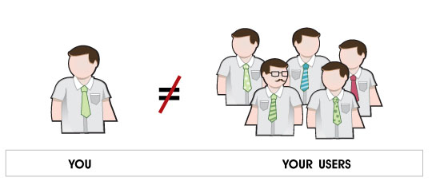
Remember!

Slide 7
What will you learn?
How to draft a user research plan
Recruitment
Conducting interviews

Slide 8
Research Plan
Formalize your research
Goals
Schedules
Budget
Communicate: highlight benefits of your research; expectation management
Management: measurable output, timing

Slide 9
Goals
Every department (even within a department) will have different priorities
Optimize revenue
Strong branding
Bug free code
Minimize customer complaints

Slide 10
Not all priorities will benefit the end-user

Slide 11
Goals
Collect issues and present them as goals
Identify the stakeholders
Get their input (also creates buy-in)
Prioritize the goals
Importance x severity = priority
Rewrite the goals as questions
Goal: E.g.: decrease return of broken microwaves
Question: E.g.: why do the microwaves brake down?

Slide 12
Goals
Do not go into user research to prove a point
We want to know what people really want and how they are
Be as open-minded as you can in collecting issues, even fundamental ones
Learn the product thoroughly from a user perspective
Manual
Training course
Tech support

Slide 13
Goals
Be careful with assumptions!

Slide 14
Schedules
Try to tackle big issues first
General methods before specific ones
Synchronize/integrate with the product development schedule
Create relevant outputs along the way
Plan for design review meetings

Slide 15
Ex. Early Design Schedule
Internal discovery: business requirements
Survey: demographic segmentation
Log file analysis: current user behavior
User profiling: know thy user!
Usability testing of existing products
Contextual inquiry: uncover current problems
Task analysis: how does the user solve the tasks now?
Focus groups/competitive focus groups: reflect on proposed solutions

Slide 16
Ex. Development & Design Schedule
Iterative cycles of usability testing using prototypes, from lo-fi to mid-fi to hi-fi to alpha to beta release
Competitive usability tests allow benchmarking against competition and improvement of own product

Slide 17
Ex. After Release Schedule
Survey and log file analysis to compare changes in the product to past behavior
Diaries to track long-term behavior changes
Contextual inquiry to study how people are using the new product

Slide 18
Selection of methods
Evaluation without users:
Expert reviews, heuristic evaluations
Psychological modelling, personas
Evaluation with users:
Observation and monitoring
Field studies, ethnography
Users opinions (more or less participative)
Surveys, focus groups, probes, participatory design
Experiments and benchmarks

Slide 19
Interviews
Users needed: ~5
Lifecycle stage: Task & environment analysis, early design stages
Main advantage: Flexible, in-depth attitude and experience probing
Main disadvantage: Time-consuming. Hard to analyze and compare.
Variations: contextual inquiry (e.g. tech-tours), scenario’s, guided speculation

Slide 20

Contextual Inquiry
Interviews in work context
Master – Apprentice
Work objects available
Easier to address realistic issues
but: Interruptions

Slide 21

Focus Groups
Users needed: 6-9 per group
POBA talk (Perceptions, Opinions, Beliefs & Attitudes)
Lifecycle stage: Early development, feature definition, user involvement
Main advantage: Spontaneous reactions (priorities, desires, anecdotes) and group dynamics
Main disadvantage: Groupthink. Social demand characteristics. Desires vs. needs.

Slide 22
Ex. Focus Groups
Early: discuss context of use of speech control for consumer products, to understand requirements for new product
Late: show concrete product, and discuss possible uses, advantages and disadvantages

Slide 23
Questionnaires/Surveys
Users needed: At least 30 (more is better)
Lifecycle stage: Early design, follow-up studies
Main advantages: Finds subjective user preferences. Quantitative description of audience demographics. Easy to repeat (large groups) & to analyze. Anonymity.
Main disadvantages: Questionnaire development is time intensive: item construction, scale construction, establishing reliability and validity - pilot tests required. Sample bias: who will respond? Response bias. No further probing possible (i.e., you cannot ask why?).

Slide 24
Probes
Users needed: ~5 clusters (e.g. families)
Lifecycle stage: environment analysis, early design stages.
Main advantage: In context. Over time. Personalized. Rich design inspiration.
Main disadvantage: Little control. Response bias. Hard (if not impossible) to analyze.
Variations: cultural probes (Gaver), technology probes (InterLiving)

Slide 25
Observations
Users needed: 5 or more
Lifecycle stage: Task and environment analysis, follow-up studies
Main advantage: Ecological validity; reveals users’ real tasks. Suggests functions and features.
Main disadvantage: No experimenter control. Intrusive. Experimenter can affect user behavior. Time-consuming data analysis.
Variations: participatory observation

Slide 26
Observations
What to observe?
Which activities? E.g.
Representative sample
Only new functionality/tasks
Global use
Where? Lab, field study
When?
Learning phase, and/or expert use
Once, or more observations over time

Slide 27
Observations
How? Non-obtrusive..
What? Time, errors, …
Interacting with what? Final product, prototype

Slide 28
Types of Observations
Participatory observation :
Researcher participates in activities, e.g. with or without others knowing
Non-participatory observation:
Non-intrusive
Less chance of bias

Slide 29
User Tests
Users needed: At least 10+
Lifecycle stage: Competitive analysis, benchmarking, final testing
Main advantage: Controlled study. Quantitative data. Results easy to interpret and compare (Benchmarking). Replicable.
Main disadvantage: Low generalizability. Tasks
often artificial and restricted. Time-intensive.

Slide 30
Thinking Aloud
Users needed: 3-5
Lifecycle stage: Formative evaluation, iterative design
Main advantage: Pinpoints user misconceptions. Cheap test.
Main disadvantage: Unnatural for users. Hard for users to verbalize.
Variations: peer tutoring, co-discovery

Slide 31
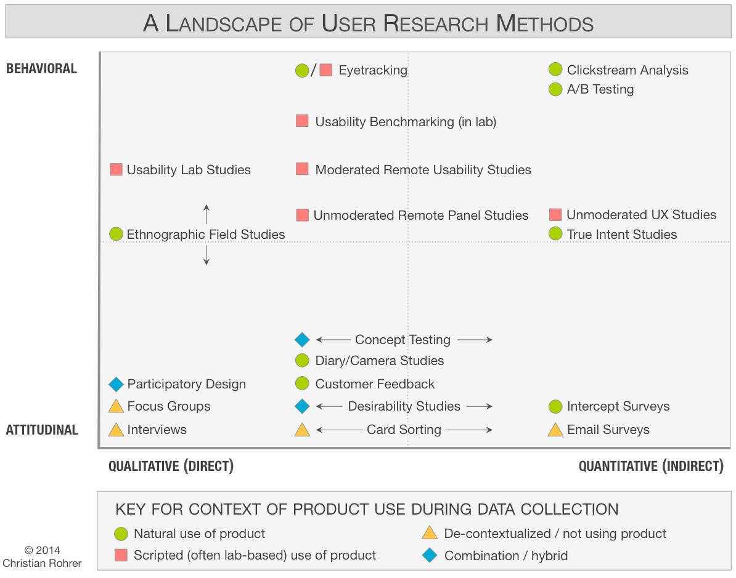
When to Use What?

Slide 32
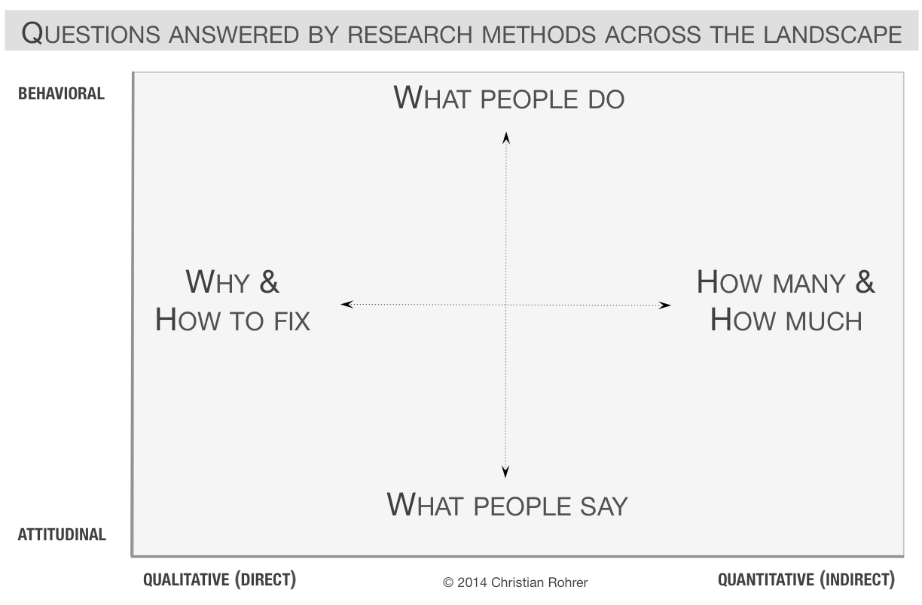
When to Use What?

Slide 33
When to Use What?
 | Product Development Phase
 | Strategize | Execute | Assess
Goal: | Inspire, explore and choose new directions and opportunities | Inform and optimize designs in order to reduce risk and improve usability | Measure product performance against itself or its competition
Approach: | Qualitative and Quantitative | Mainly Qualitative (formative) | Mainly Quantitative (summative)
Typical methods: | Field studies, diary studies, surveys, data mining, or analytics | Card sorting, field studies, participatory design, paper prototype, and usability studies, desirability studies, customer emails | Usability benchmarking, online assessments, surveys, A/B testing

Slide 34

User Population

Slide 35
User Representation
Expert user? Real user?

Slide 36
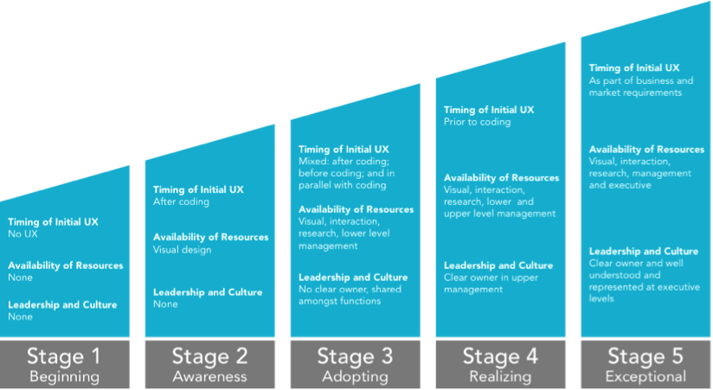
Timing of Involvement

Slide 37
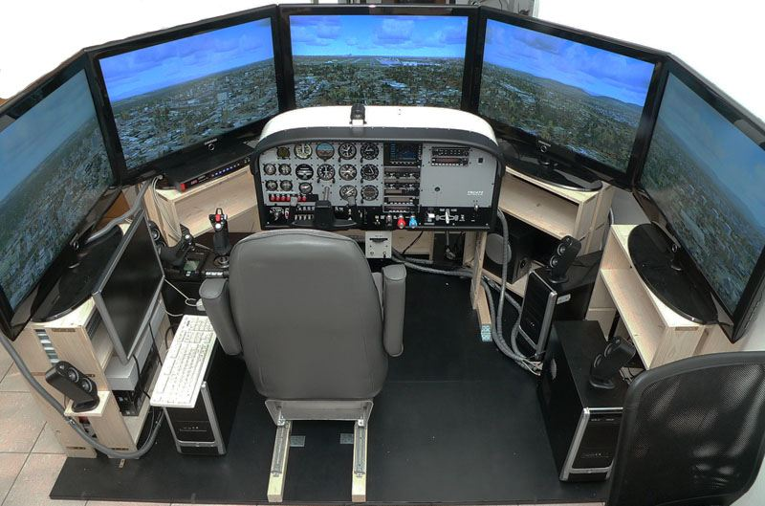

Location of Analysis
Laboratory? In Context?

Slide 38
Research Plan Format
Set expectations
Be realistic; don’t oversell
Who is doing what when?
Specific for short term, more general for long-term
Specify goals
Specify outputs: these should be tangible, measurable deliverables
Reports, presentations

Slide 39
Budgeting
Cost
Staff time * hourly rate
Recruiting and incentive cost
Equipment cost (incl. location rental)
Incentives differ depending on user population
As a rule of thumb, user centered research can be estimated at around 10% of the total development cost

Slide 40
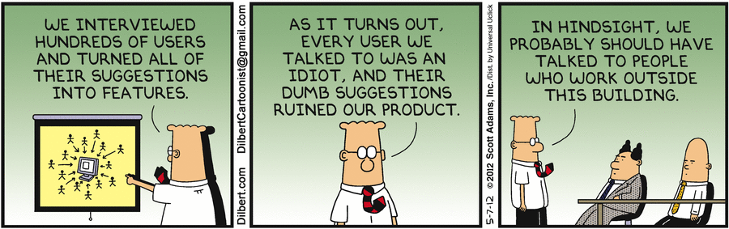
Recruiting

Slide 41
Recruiting
“If you get the wrong people to talk about your product, your research can be worse than useless since it gives you confidence in results that don’t represent the views and behaviors of your real users.”

Slide 42

Recruiting: selection

Slide 43
Recruiting: selection
Profile your users
Age
Gender
Education
Income
Technology Experience
etc.

Slide 44

Recruiting: finding
Start with friends and family
Parents, colleagues, housemates, ...

Slide 45
Recruiting: finding
Expanding your horizon
Community mailing lists, bulletin boards
(Corporate/university) neighbors
Users of your current product
New employees
Past research participants
Ads on the web or in newspapers
Local housing complexes
Flyer
Websites/forums
…

Slide 46
Recruiting: finding
Expanding your horizon
Community mailing lists, bulletin boards
(Corporate/university) neighbors
Users of your current product
New employees
Past research participants
Ads on the web or in newspapers
Local housing complexes
Flyer
Websites/forums
…
Be creative and persistent!

Slide 47
Recruiting: Do’s & Don’ts
Never spam!
Be careful of “next-bench” recruiting
Keep track of which recruiting techniques work well
Regularly update your participant database
Keep track of “good” participants, delete “bad” ones
Be careful with repeat recruits within a short timeframe
Professional recruiters can be useful when time is short
However they don’t know your business like you do
Personal data should be kept in accordance to the existing laws and legislation around personal privacy and data protection

Slide 48
Recruiting: scheduling
Define scheduling window
Write and send invitations
Be clear about the goal of the study without giving away too much detail
Be clear about the time/date, location, incentive
Be clear about voluntary nature of the study and protection of personal privacy
Confirm and reconfirm
Schedule potential backup candidates

Slide 49
Recruiting: pitfalls
The wrong people
No-shows
Severity depends on criticality of their role and input
Double scheduling
Floater
“Makeup” slots
Bias
Be aware of the potential bias in your sample: a truly random sample is impossible!
Anonymity of your company
Building and space preparation
“everyone they meet should be expecting them”

Slide 50
Interviewing
Critical technique to elicit information on the user experience
Interviews are particularly useful for getting the story behind a participant’s experiences. Interviews may be useful as follow-up to certain responses to questionnaires

Slide 51
Interviewing
When to do an interview:
There is a need to attain highly personalized data.
There are opportunities required for probing.
A good return rate is important.
Respondents are not fluent in the native language of the country, or where they have difficulties with written language.

Slide 52
Interview Types
Informal, conversational interview
no predetermined questions are asked, in order to remain as open and adaptable as possible to the interviewee’s nature and priorities; during the interview the interviewer “goes with the flow”.
General interview guide approach
the guide approach is intended to ensure that the same general areas of information are collected from each interviewee; this provides more focus than the conversational approach, but still allows a degree of freedom and adaptability in getting the information from the interviewee.

Slide 53
Interview Types
Standardized, open-ended interview
The same open-ended questions are asked to all interviewees; this approach facilitates faster interviews that can be more easily analyzed and compared.
Closed, fixed-response interview
Where all interviewees are asked the same questions and asked to choose answers from among the same set of alternatives. This format is useful for those not practiced in interviewing.

Slide 54
Interview: preparation
Organize and rehearse!
Choose a setting with the least distraction.
Prepare a method for recording data, e.g., take notes, audio recording.

Slide 55
Interview: preparation
Researcher needs to make sure respondents have:
A clear idea of why they have been asked;
Basic information about the purpose of the interview and the research project of which it is a part;
Some idea of the probable length of the interview and that you would like to record it (explaining why);
A clear idea of precisely where and when the interview will take place

Slide 56
Interview: structure
Introduction: introduce participants, make everyone feel comfortable
Warm up: get into Q&A mode
General issues: attitudes, expectations, assumptions, experiences
Deep focus: e.g., introduce specific innovations
Retrospective: step back, evaluate
Wrap-up: summary, administration

Slide 57
Interview: being non-directed
Non-directed interviewing is the process of conducting interviews that do not lead or bias the answer
We want to know people’s thoughts and not confirm our own biases
It’s difficult to be entirely neutral!
Forget about company pride and all the effort and commitment that was put into a product
Distance yourself from the product – try to be as rigorous as possible in your neutrality

Slide 58
Interview: being non-directed
Do not force opinions; be aware of your own expectations
Restate answers: verify your understanding
Follow up with examples but wait for an undirected answer first
Use artifacts to keep people focused and to trigger ideas
Never say the participant is wrong
Listen carefully to the questions posed to you by the interviewee
Create a report immediately after the interview; Always review your tapes to check if you missed something

Slide 59
Interview: non-directed questions
Try to avoid leading questions
Example (invocation of peer pressure):
More people in the City are using our beauty products
than any other brand. Do you use our beauty products?
A. Yes
B. No
Another example:
Since cigarettes are dangerous and have deadly side effects such as cancer wouldn't you agree that smoking should be controlled to save the lives of many? (yes=7; no=3)
Should people have the right to smoke? (yes=9; no=1)

Slide 60
Interview: non-directed questions
Focus on immediate, concrete experiences
Not: Is this interesting to you?
But: If it were available to you right now, would you use it? Why?
Focus on a single topic – avoid ambiguity
Keep questions open-ended
Not: Which feature is most important to you?
But: Does the product do anything that is useful to you? If so, what is it? What makes it useful?
Avoid binary (yes/no) questions

Slide 61

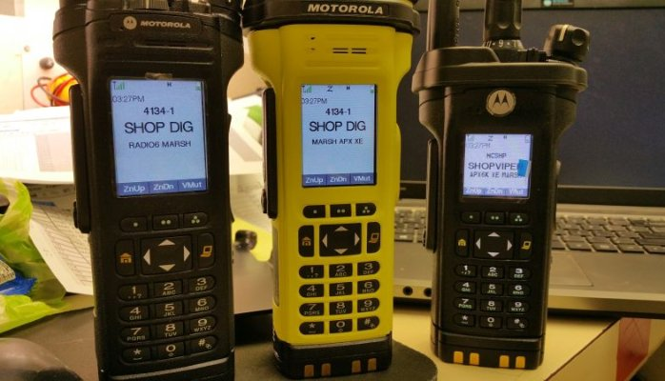
Complicated Fire Department Radios Live Endangering

Slide 62

“Rather have a bulky device with big buttons!”

Slide 63
